Slide 1
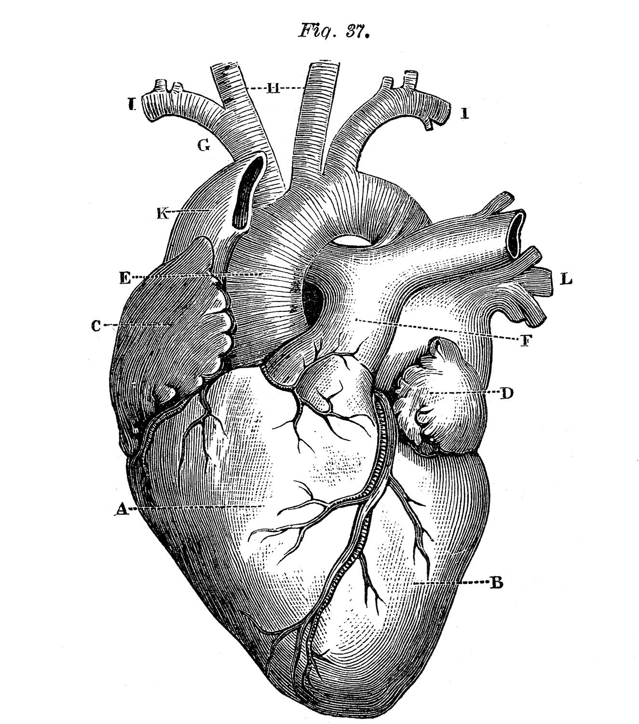
Congenital heart disease
Dr Kasia Piróg
IGM, Newcastle University

Slide 2
Congenital = present from birth
9 in 1,000 babies born in the UK
in many cases it is a minor problem which either doesn't need any treatment or can be successfully corrected with surgery
causes:
  chromosome defects, such as Down's syndrome – a genetic disorder that affects a baby's normal physical development and causes learning difficulties
  other chromosome and genetic defects, which can be inherited
  certain infections in the mother, such as rubella, during pregnancy
  the mother having poorly managed diabetes

Slide 3
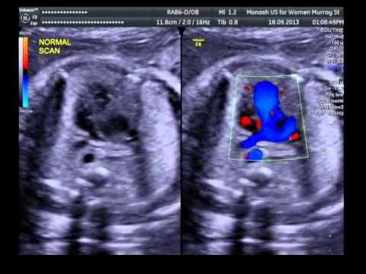
How do we detect it?
A number of symptoms, including:
  rapid heartbeat
  rapid breathing
  excessive sweating
  extreme tiredness and fatigue
  a blue tinge to the skin (cyanosis)
  tiredness and rapid breathing when a baby is feeding
Note: mild defects may not cause any problems until later in life

Slide 4
How does it happen?
GENE
2ND GENE
switch other genes on or off
codes for
Can
Can
tell the embryo which side is left or right and should have the heart on it.
Protein
which…
To
Can
Can
Can
To
work with other proteins
tell heart cells to become muscle or blood vessel lining
tell cells to grow, stop growing, or die off

Slide 5
Types of congenital heart disorders
hole in the heart – between two of the heart's chambers (septal defect)
narrowing of the aorta – the main large artery of the body, called the aorta, is narrower than normal (coarctation)
narrowing of the valve, which controls the flow of blood out of heart to the lungs(pulmonary valve stenosis)
the pulmonary artery and the aorta swap places (transposition of the great arteries)

Slide 6
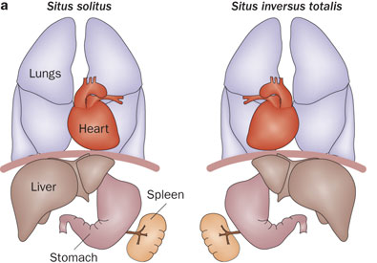
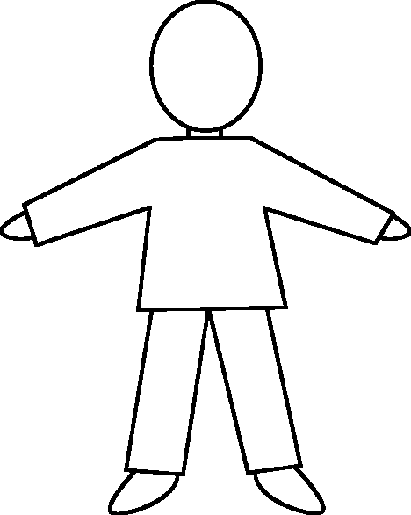


Dextrocardia
Less than 1% of the population
Isolated or situs inversus
Solitus
Inversus

Slide 7
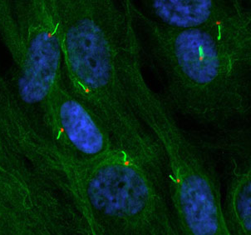
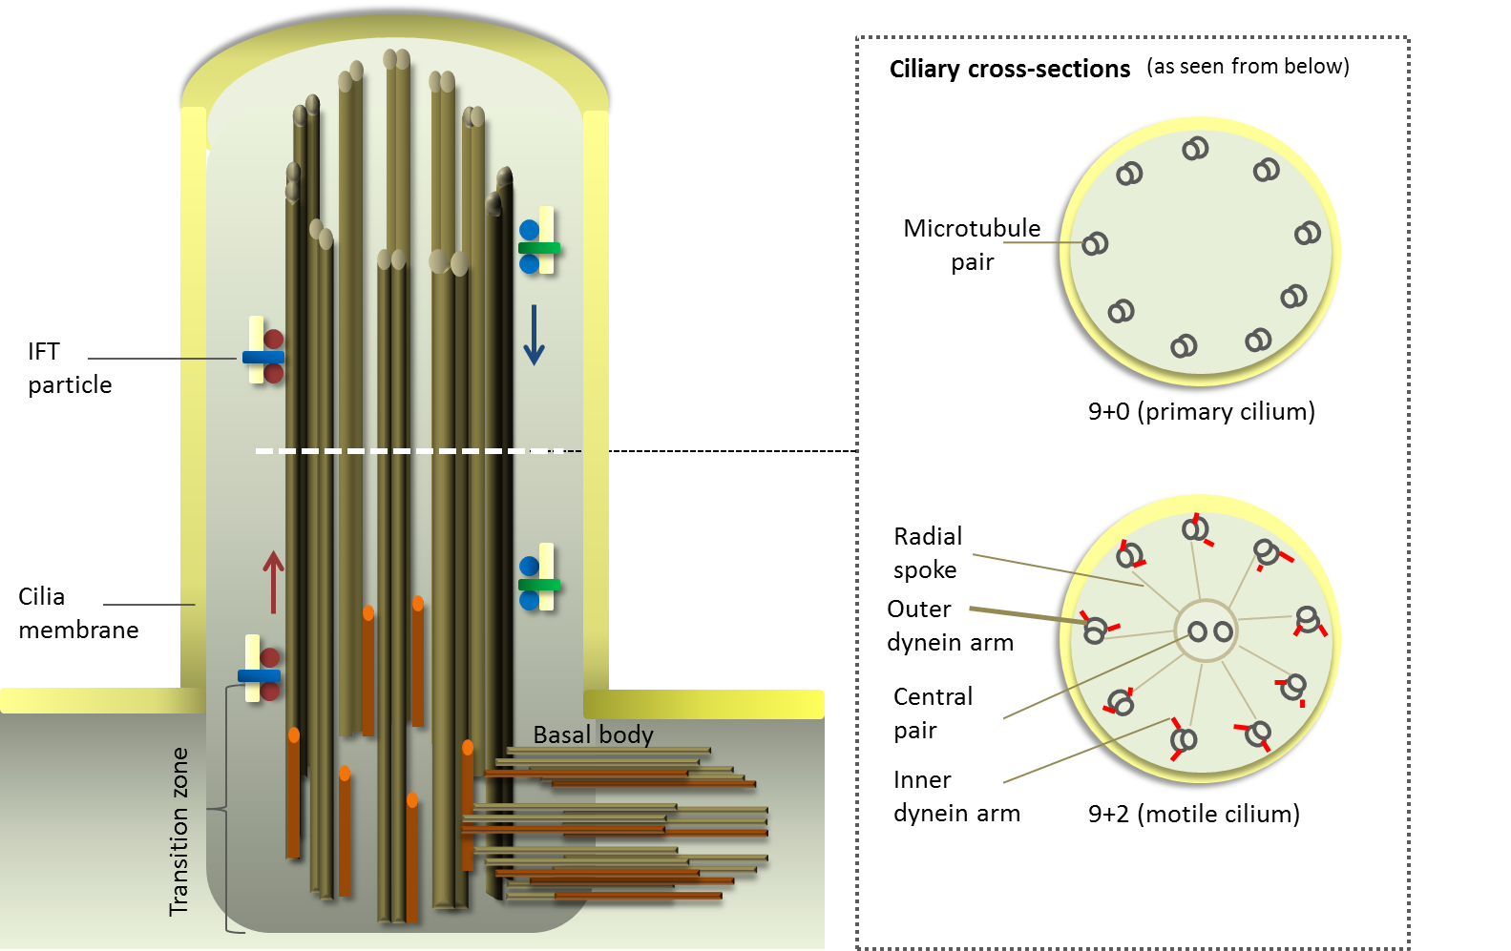
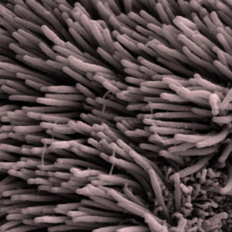
Situs inversus – how?

Slide 8
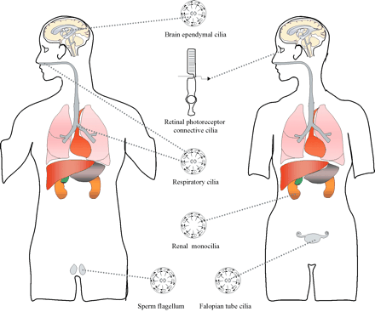
Cilia and human disease
Hum. Mol. Genet. (2003) 12 (suppl 1): R27-R35

Slide 9
“Blue baby syndrome”
Tetralogy of Fallot (tetralogy = fourfold)
most common cause of “blue baby syndrome”
narrowing at or below the pulmonary valve = blood has difficulty getting from the right ventricle into the pulmonary artery (pulmonary stenosis)
a hole in the wall between the right and left ventricles of the heart = mixing of blood (ventricular septal defect (VSD) )
the entrance to the aorta, which should only take oxygenated blood around the body, lies over the ventrical hole = deoxygenated blood gets into the aorta (over-riding aorta)
right ventricle becomes thickened as it forces blood into the narrowed pulmonary artery (right ventricular hypertrophy)

Slide 10
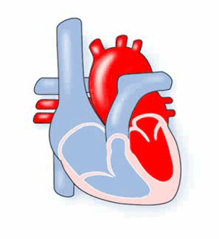
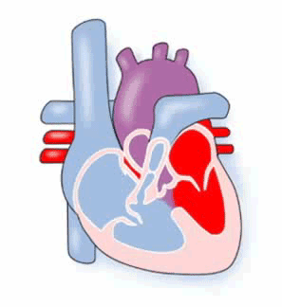
Tetralogy of Fallot

Slide 11
Causes and treatment of TOF
Symptoms:
  children with tetralogy of Fallot may develop "tet spells“ characterized by a sudden, marked increase in cyanosis followed by fainting
  these may result in hypoxic brain injury and death
Treatment:
  TOF is treated with corrective surgery, usually within the first year of life, but presents with long-term problems
Cause is currently unknown:
  several genes have been associated with TOF
  DiGeorge syndrome (chromosome 22 deletions)

Slide 12
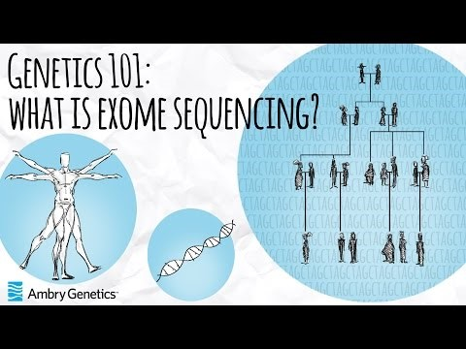
Finding the unknown genes

Slide 13
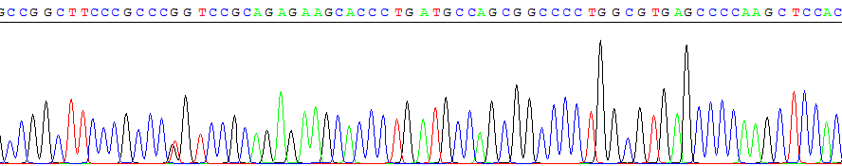
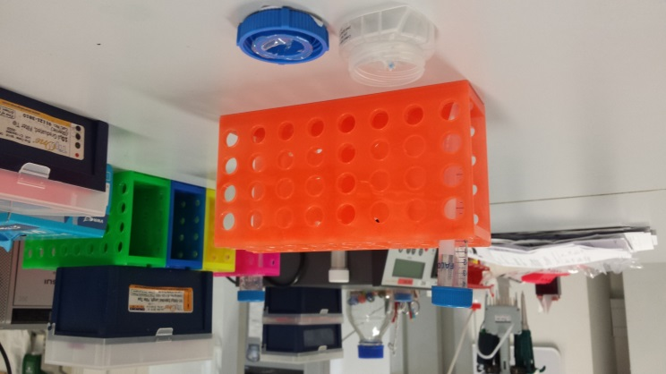
Finding the unknown genes
Exome sequencing of DNA from families with CHD
Which are the important genes?
Which genes are more likely to be mutated, copied or deleted in CHD patients and their families?
Are the mutations going to stop the protein from working properly?

Slide 14
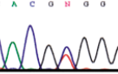
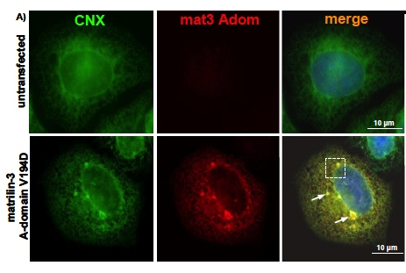
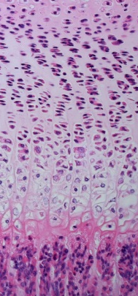
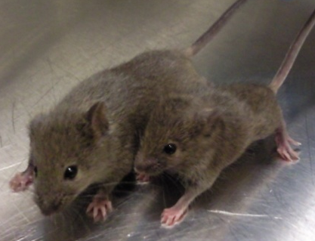
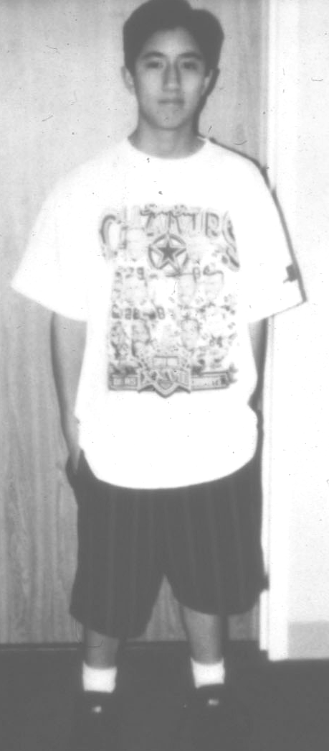
Forward genetics

Slide 15
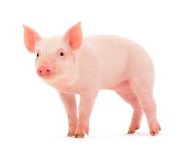
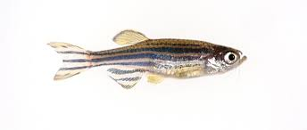
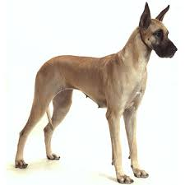
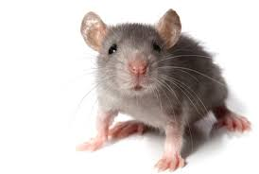
Animal models of cardiovascular disease

Slide 16
Questions

